Slide 1


Other Web Service and Application Development Platforms
Remotable and Nonremotable Objects
AJAX Programming
Java-Based Web Service and Application Development

Slide 2
SOC Software Development Environments
SOC Software Development Environment | Platform- independent Web service | Platform- dependent service | Distributed transactions | WS-* specification | Primary language
ASMX (ASP .Net) | X |  |  |  | C# / VB
.Net Remoting |  | X |  |  | C#
Services: BizTalk |  |  | X |  | XLang / BPEL
WSE: WS Enhancements | X |  |  | X | C# / VB
WCF | X | X | X | X | C# / VB
AJAX | X |  |  |  | Java Script
Eclipse / Axis2 / Tomcat | X | X | X | X | Java
JEE: Java Edition | X | X | X | X | Java / Java Script / JavaBeans
JDeveloper / Oracle SOA Suite |  |  | X | X | BPEL
ActiveBPEL / Tomcat |  |  | X | X | BPEL
WebSphere |  |  | X | X | BPEL / Java

Slide 3
Remotable and Nonremotable Objects
Nonremotable objects cannot leave their application domain;
They cannot be copied (migrated), or represented in another application domain through a proxy;
They are always accessed directly from their application domain;
They are used in traditional object-oriented computing
Most base classes in the .NET Framework class library are nonremotable.

Slide 4
Remotable Objects
Remotable objects can be accessed outside their application domain or context using a proxy;
They can be copied, and these copies can be passed outside their application domain or context;
Some remotable objects are passed by reference and some are passed by value (pass the object itself);
There are two main kinds of remotable objects in .Net:
Marshal-by-value objects, which are copied and passed from the application domain (migration);
Marshal-by-reference objects, for which a proxy is created and used by the client to access the object remotely (model of Web service).

Slide 5
What is the difference between a Marshal-by-reference object and a Web service

Slide 6
.Net Remotable Object
Client
application domain
Sever
application domain
Client
Object copied
from server
Marshal-by-
value object
Channel
Proxy
Channel
Marshal-by-
Reference object

Slide 7
A Remotable Class on Server
using System;
public class SvrClock : MarshalByRefObject
{
public string GetCurrentTime ()
{
return DateTime.Now.ToLongTimeString ();
}
}

Slide 8
A Client Accessing a Remotable Class on Server
Does the program need to run at admin mode?
using System;
using System.Runtime.Remoting;
using System.Runtime.Remoting.Channels;
using System.Runtime.Remoting.Channels.Tcp;
class MyApp {
static void Main () {
TcpClientChannel channel = new TcpClientChannel ();
ChannelServices.RegisterChannel (channel);
RemotingConfiguration.RegisterWellKnownClientType
(typeof (SvrClock), "tcp://localhost:1234/SvrClock");
SvrClock myClock = new SvrClock ();
Console.WriteLine (myClock.GetCurrentTime ());
}
}
Create
Register
Bind
Create proxy
Access
Does it generate a real object or a proxy?

Slide 9
Web Services vs. Remotable Objects
In a Web service
A “Web Method” or “Operation Contract” makes a method remotable
Only Marshal-by-reference is used
Marshal-by-value is not implemented, because code integration (migration) can happen in the same language environment only. It does not support the platform-independent requirement.
ASP .Net and WCF create WSDL interface, while .Net remotable (marshal-by-reference) does not.

Slide 10
AJAX Programming
Asynchronous JavaScript and XML

Slide 11
AJAX Programming
AJAX programming is supported in Java and in C# Web programming environments;
AJAX is a technology to build dynamic web pages on the client side executed in Web browser;
Key benefit: Responsiveness: Partial data refresh
Request and data processing can be implemented at the client and server sides.
Data is read from the server or sent to the server by JavaScript requests;

Slide 12
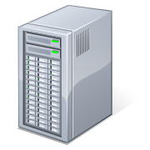
How Does a Server Page Work?
Browser refresh
Page refreshed
A mouse click
Server Page
ASU Engineering Building
699 S Mill Avenue
Server generate a new HTML page

Slide 13
Example of an AJAX Application
http://java.sun.com/javaee/javaserverfaces/ajax/tutorial.jsp
A feature of AJAX is to make the user interfaces of web applications more responsive and interactive by updating only part of the page at a time.
Client Machine
Server
Browser
Web server / Web services
Server side
request processing
①
HttpRequest
②
③
Data
processing
④
⑦
JavaScript
call
Update
JavaScript
Data
request
Data
⑤
XMLHttpRequest
⑥
XML Data post back in the same page
Database
XMLHttpRequest
Callback()
Application workflow / processing

Slide 14
Sample Code to Call the Server Side Service http://developer.mozilla.org/en/docs/AJAX:Getting_Started
<script type="text/javascript" language="javascript">
function makeRequest(url) {
var httpRequest;
if (window.XMLHttpRequest) { // Mozilla, Safari, ...
httpRequest = new XMLHttpRequest();
if (httpRequest.overrideMimeType) {
httpRequest.overrideMimeType('text/xml');
}
}
else if (window.ActiveXObject) { // IE
try {
httpRequest = new ActiveXObject("Msxml2.XMLHTTP");
} catch (e) {
try {
httpRequest = new ActiveXObject("Microsoft.XMLHTTP");
} catch (e) { }
}
}
Creating a request object
Creating a hosting object

Slide 15
Contd.
httpRequest.onreadystatechange = function() { alertContents(httpRequest); };
httpRequest.open('GET', url, true);
httpRequest.send(null);
}
function alertContents(httpRequest) {
if (httpRequest.readyState == 4) {
if (httpRequest.status == 200) {
alert(httpRequest.responseText);
} else alert('There was a problem with the request.');
}
}
</script>
<span
style="cursor: pointer; text-decoration:
underline"onclick="makeRequest('test.html')">
Make a request
</span>
Call a server function to reload data
Main code

Slide 16
Drawbacks of AJAX Programming
You need to program your client page in JavaScript, which could be complex;
Single page implementation: Does not support transitions between pages;
Not all browsers support AJAX and JavaScript.
Solution
AJAX on server side as a server control
e.g., ASP .Net server side AJAX
on other server platforms

Slide 17
AJAX Programming on ASP .Net
ASP .Net AJAX (previously called Microsoft Atlas)
combines ASP .Net server controls and the traditional AJAX. For example, you can take an existing application and add additional client-side behaviors using ASP .NET AJAX;
is a part of VS 2008 or later version.
Resources and Tutorials available at: http://www.asp.net/ajax
AJAX Control Toolkit Download: http://ajaxcontroltoolkit.codeplex.com/

Slide 18
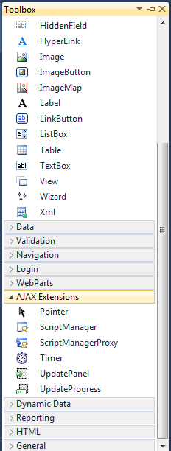
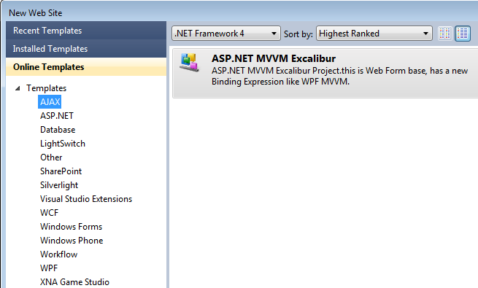
Installing AJAX Control Toolkit
In Visual Studio 2010
Install AJAX

Slide 19
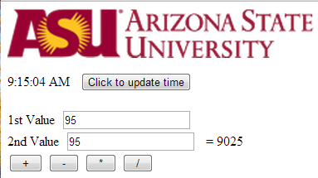
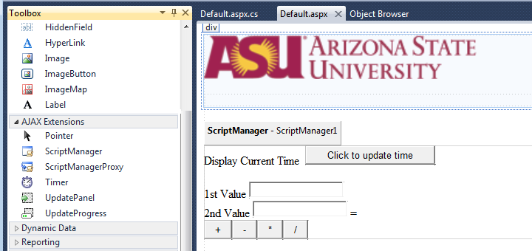
AJAX Programming under ASP .Net
Demo:
Without reloading large files such as photo
Without clear the data you have entered
Define the area in which partial data refresh is allowed
Label
Button
TryIt: http://venus.eas.asu.edu/wsrepository/AjaxIn/Default.aspx

Slide 20
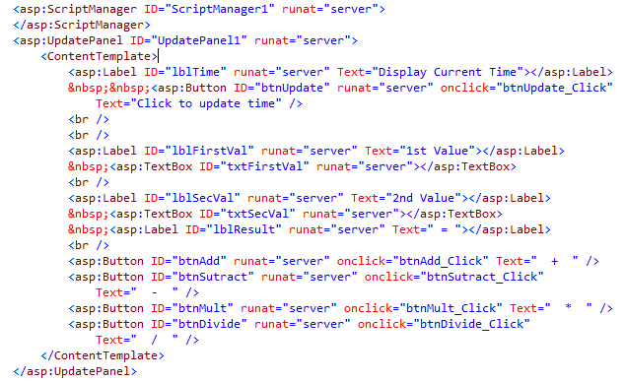
ASPX Source Code behind GUI Design
Define the area in which partial data refresh is allowed

Slide 21
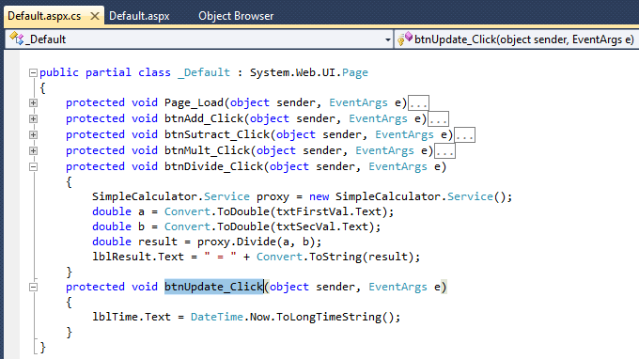
C# Code behind the Button

Slide 22
Java-Based Web Services Development Environments
Using Apache Tomcat, Eclipse, and Axis2 Web Tools Platform
Using Apache Tomcat, Eclipse, and IBM Web Tools Platform

Slide 23
ASP .Net versus Java-based SOC Development Environments
OO Programming Languages
C#, J#, and VB
Java
OO Development Environment
Visual Studio for OOC
Eclipse
…
Other IDEs
SOC Development Environment
ASP .Net / WCF for SOC
Axis2
…
IBM WTP
Service Hosting
.Net Development Server / IIS
Tomcat
…
Oracle SOA Suite

Slide 24
What is Axis2?
http://ws.apache.org/axis2/
Axis2 was first released in 2005
Send and receive SOAP messages
Create a Web service out of a plain Java class
Create implementation classes for both the server and client using WSDL standard
Create WSDL file for a service
Axis2
Java Object
Method calls in proxy
SOAP message generated
SOAP over HTTP
Client
Server
SOAP over HTTP
SOAP message received
Java method calls
Java Object

Slide 25
Further Features of Axis2
Send and receive SOAP messages with attachments
Create or utilize services that take advantage of the Quality of Services recommendations (chapter 6)
WS-Security,
WS-ReliableMessaging,
WS-Addressing,
WS-Coordination, and
WS-Atomic Transaction
Modular structure allowing extension for new recommendations as they emerge

Slide 26
The Predecessor of Axis2
Predecessors: Apache SOAP and Apache Axis (Axis1)
Keep the entire SOAP message in memory – DOM model of XML data processing (chapter 4)
Complex two-step deployment model involving manually copying files into the required location
Based on Remote Procedure Call (RPC) over SOAP, which requires the system to “answer” to each request (two-ways), this requirement causes problems for non-RPC style interactions, such as one-way messaging.

Slide 27
Improvements in Axis2
New SOAP Object Model
Better Support for message exchange patterns, with both synchronous and asynchronous behavior
Improved deployment model
Pluggable data binding
Improved Handlers (Filter) framework

Slide 28
The New SOAP Object Model in Axis2
Axis1: keeping the entire SOAP message in memory
SOAP message is an XML document with a tree structure;
DOM model of XML data processing;
Consume a large piece of memory.
Axis2: keeping SOAP message outside memory
Uses SAX (Simple/Streaming API for XML) model, which reads in SOAP object on demand in a stream (chapter 4), one node at time;
Cannot read the document back and forth

Slide 29
Better Support for Message Exchange
Axis2 moves to WS-based Message-Style Interaction.
Two Ways
Server
Client
Synchronous communication: Have to wait for the response. It may hold the client for a long time.
Axis1
Semi-Two Ways
Server
Client
Automatic confirmation
Asynchronous communication without blocking the client. The sever can call back
One Way
Server
Client
. . .
Another One Way

Slide 30
RPC versus WS Remote Invocation
RPC (Remote Procedure Call) is characterized by
Tightly coupled with control flow dependency
Two-way blocking call
Synchronous communication
Platform dependent, e.g., .Net to .Net, and Java to Java
Web Service Remote Invocation
Tightly and loosely coupled
Two-way blocking and one-way non-blocking calls
Synchronous and asynchronous communications
Platform independent, with WSDL and SOAP wrapping
Thus, RPC is a special case of Web service remote invocation, in terms of their functionality.

Slide 31
Hot Deployment Model in Axis2
Axis2 is equipped with the capability of deploying Web services and their handlers while the system is up and running
The new deployment model is based on an archived file system.
Each component of the Axis2 configuration is stored in an archive or a configuration file, which makes it similar to the J2EE deployment mechanism.
The deployment is to deploy a single Web Service archive, in a single step.

Slide 32
Java Web Service Development Using Apache Tomcat, Eclipse, and Axis2
Require good Java programming experience
Download Tomcat
Download Eclipse IDE for Java EE
Download and configure Axis2

Slide 33
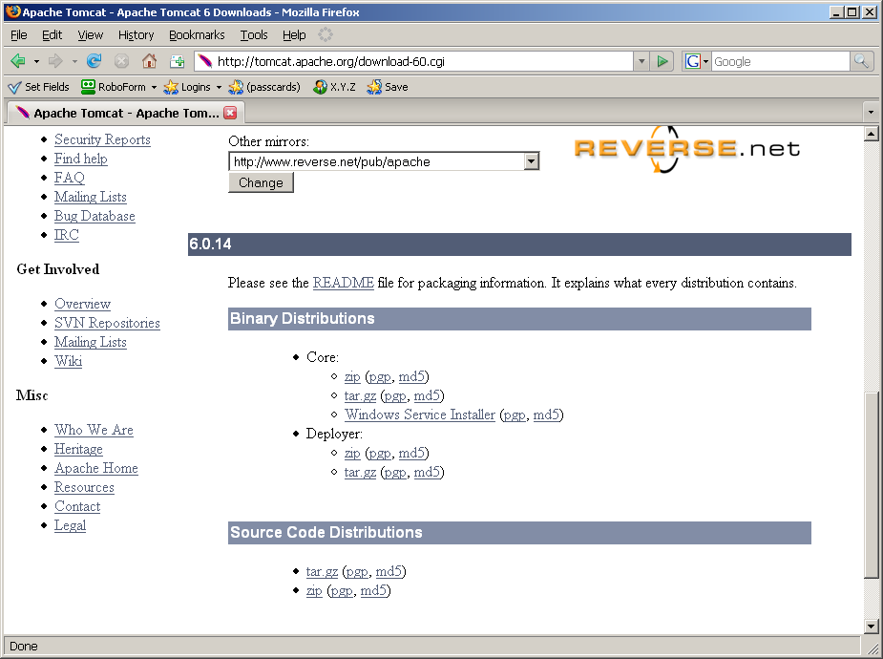
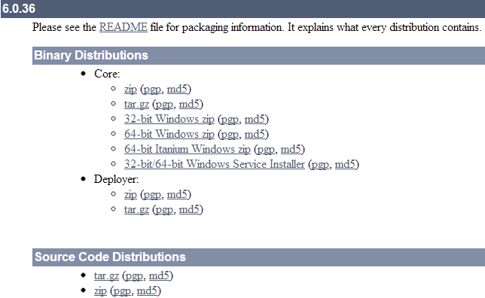
Download: http://tomcat.apache.org/download-60.cgi
Setup Wizard

Slide 34
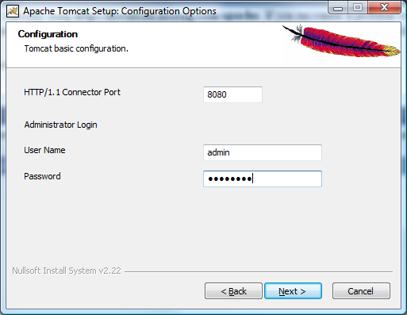
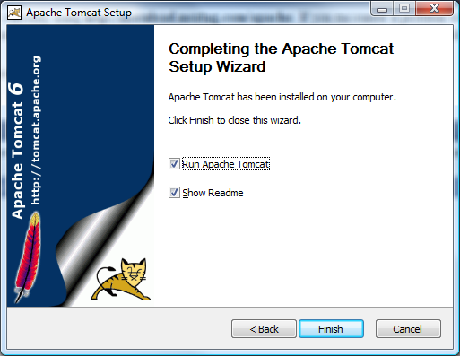
Installation / Setup Wizard

Slide 35
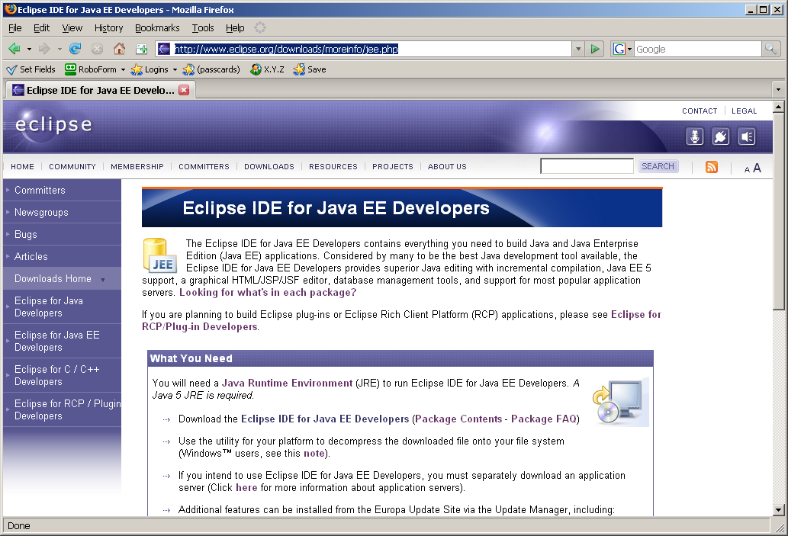
Stepe 2: Download Eclipse IDE for Java EE
http://www.eclipse.org/downloads/moreinfo/jee.php

Slide 36
Step 3: Configure Tomcat and Eclipse
The following tutorial shows how can you configure Tomcat and Eclipse:
http://www.eclipse.org/webtools/jst/components/ws/1.5/tutorials/InstallTomcat/InstallTomcat.html

Slide 37
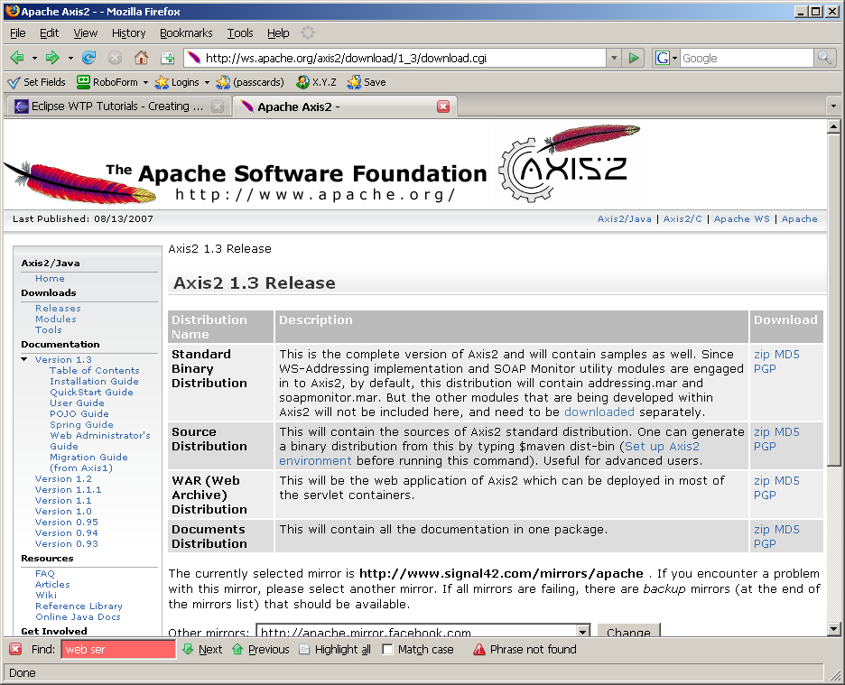
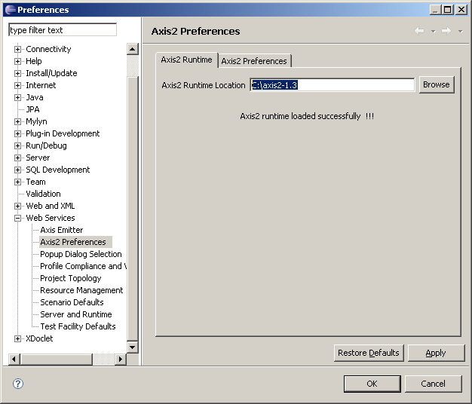
Step 4: Download and Configure Axis2
Download Axis2 from http://ws.apache.org/axis2/download.cgi
Unzip the downloaded file and run:

Slide 38
Step 4: Download and Configure Axis2
In Eclipse, choose window->preferences->web services->axis2 preferences, specify the axis2 location as the following diagram shows.

Slide 39
Creating a Complete SOC Application Using Eclipse, Axis2, and Tomcat
http://www.eclipse.org/webtools/community/tutorials/BottomUpAxis2WebService/bu_tutorial.html
Create a Web service in Java using Eclipse and Axis2
Hosting the Web service in Tomcat and publishing the Web service in UDDI
Create an application (client) that uses existing services

Slide 40
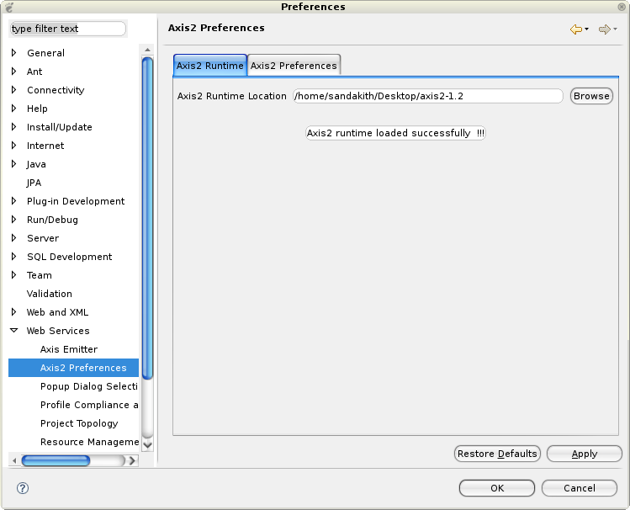
In Eclipse WTP: Open Window -> Preferences -> Web Services -> Axis2 Emitter

Slide 41
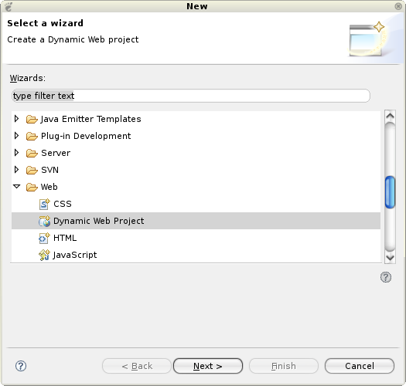
Open File -> New -> Other... -> Web -> Dynamic Web Project

Slide 42
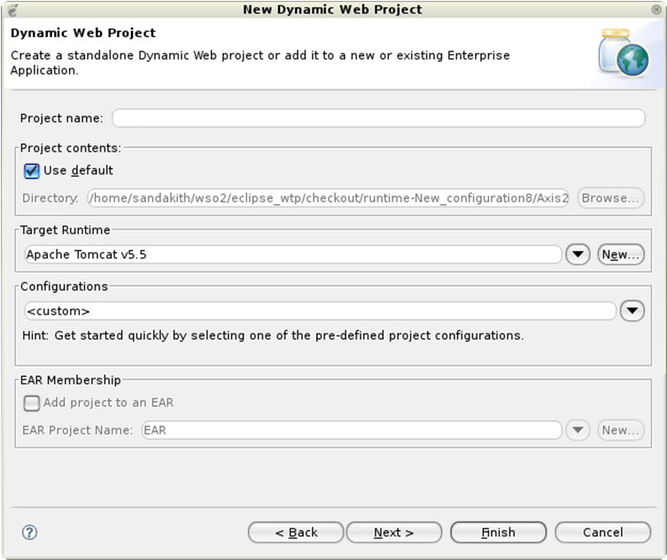
Select the configured Tomcat runtime as the target runtime
myFirstAxisProject

Slide 43
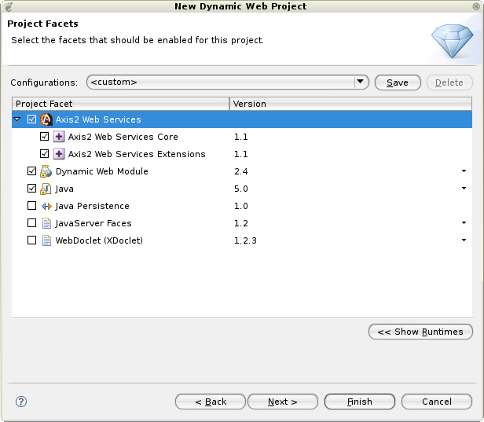
Select the Axis2 Web service facet

Slide 44
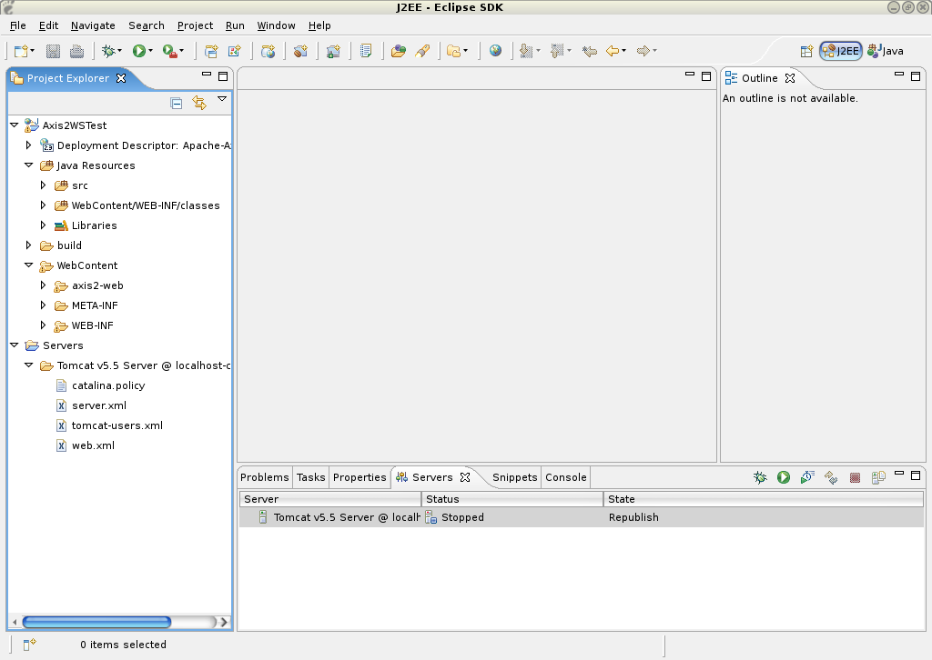
A dynamic Web Service Project is Created

Slide 45
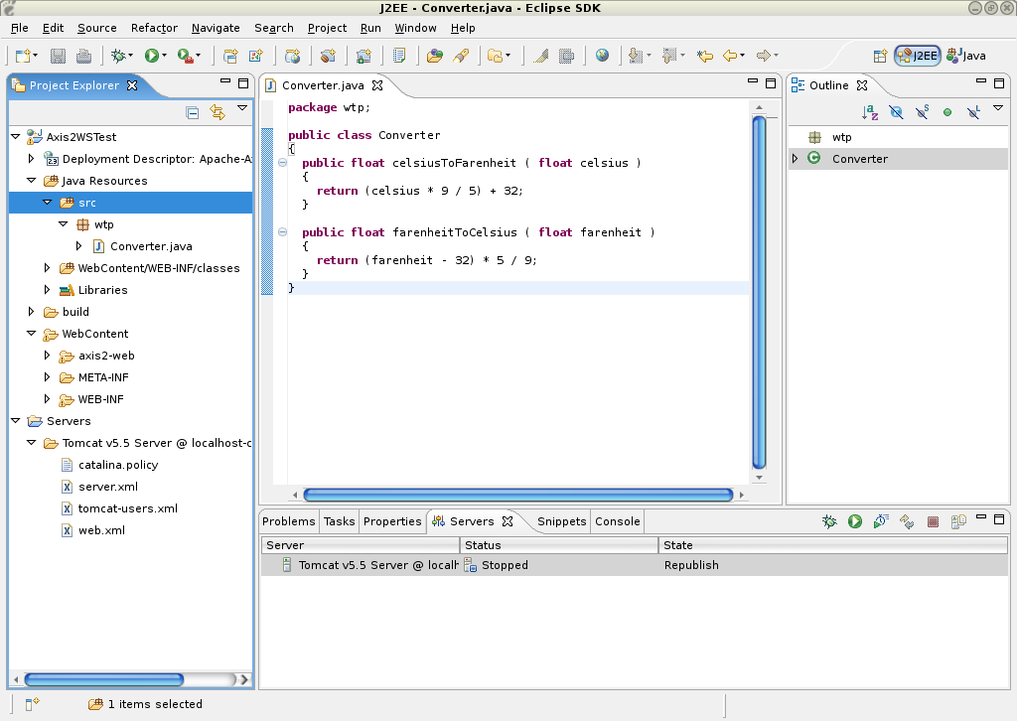
Type your Java code here

Slide 46
Creating a Complete SOC Application Using Eclipse, Axis2, and Tomcat
http://www.eclipse.org/webtools/community/tutorials/BottomUpAxis2WebService/bu_tutorial.html
Create a Web service in Java using Eclipse and Axis2
Hosting the Web service in Tomcat and publishing the Web service in UDDI
Create an application (client) that uses existing services

Slide 47
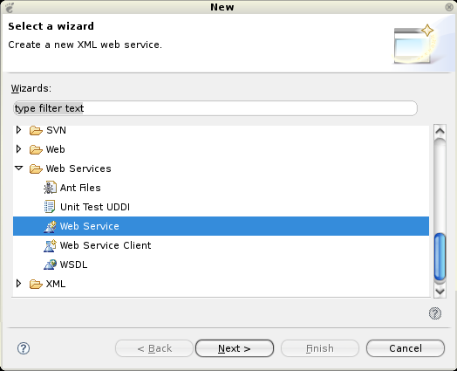
Open a WS: File -> New -> Other... -> Web Services -> Web Service

Slide 48
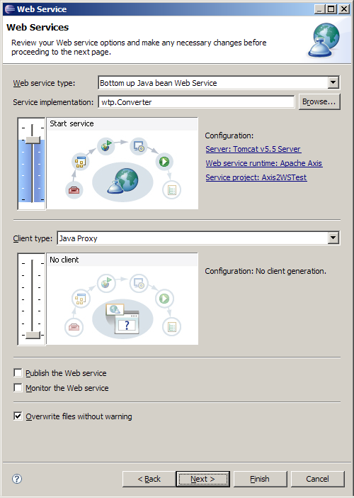
Move the service scale to Start service

Slide 49
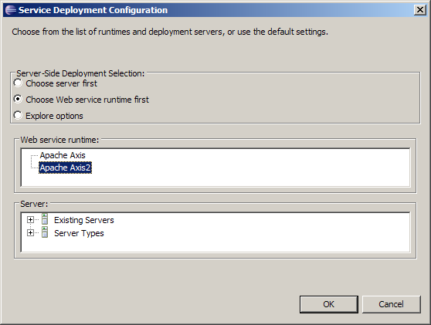
Click on the Web Service runtime link to select the Axis2 runtime

Slide 50
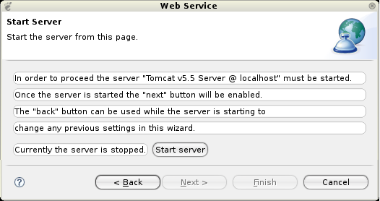
Click on the Start Server button. This will start the server runtime
The Tomcat server will be started

Slide 51
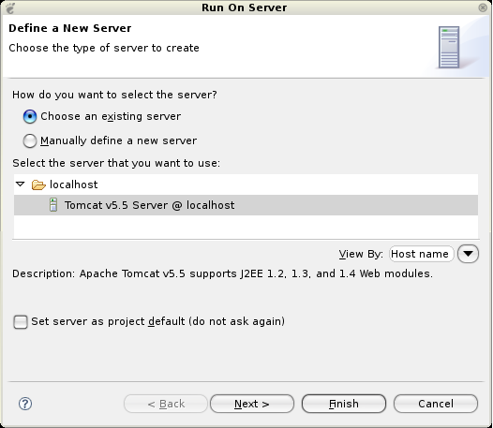
Hosting the Service in Tomcat: Select Run -> Run As -> Run on Server

Slide 52
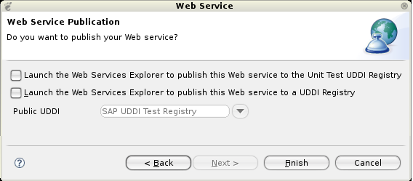
Publish the Service in an UDDI Registry

Slide 53
Creating a Complete SOC Application Using Eclipse, Axis2, and Tomcat
http://www.eclipse.org/webtools/community/tutorials/BottomUpAxis2WebService/bu_tutorial.html
Create a Web service in Java using Eclipse and Axis2
Hosting the Web service in Tomcat and publishing the Web service in UDDI
Create an application (client) that uses existing services

Slide 54
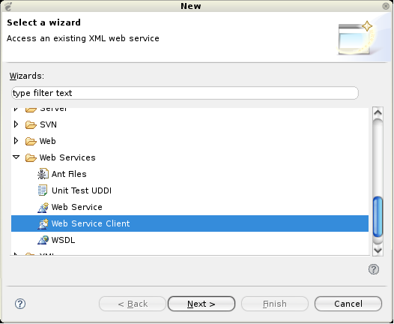
Open File -> New -> Other... -> Web Services -> Web Service Client

Slide 55
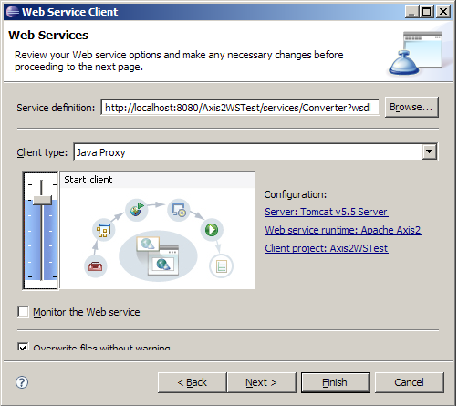
Paste the URL that was copied earlier into the service definition field
URL

Slide 56
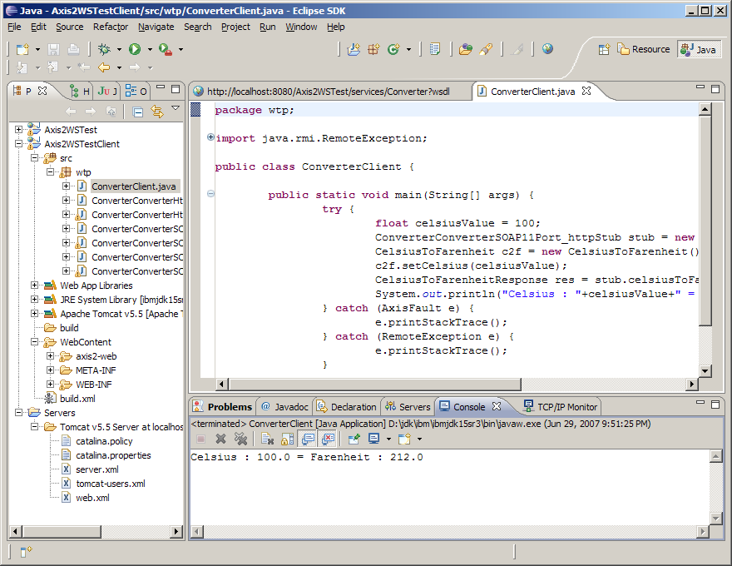
Proxy to the Web service

Slide 57
Build WS Using Eclipse and IBM Web Tools Platform (WTP)
http://www.ibm.com/developerworks/edu/os-dw-os-wtpservice-i.html
System requirements
You'll need JavaScript enabled in your browser.
You'll need to have the following software installed:
Eclipse (http://www.eclipse.org/)
IBM contribution to the Eclipse Web Tools Platform
Apache Tomcat: http://jakarta.apache.org/tomcat/
Cloudscape 10.0 or IBM DB2 Universal Database V8.2 Express

Slide 58
Eclipse Web Tools Platform
http://www.eclipse.org/webtools/initial-contribution/IBM/evalGuides/WebServicesToolsEval.html?p=1
The Web Services Explorer for publishing, discovering, and invoking Web services.
The Web Service wizard for creating new Web services bottom-up from Java or top-down from WSDL.
The Web Service Client (application) wizard for creating Web service client proxies and sample JSP clients from WSDL.

Slide 59
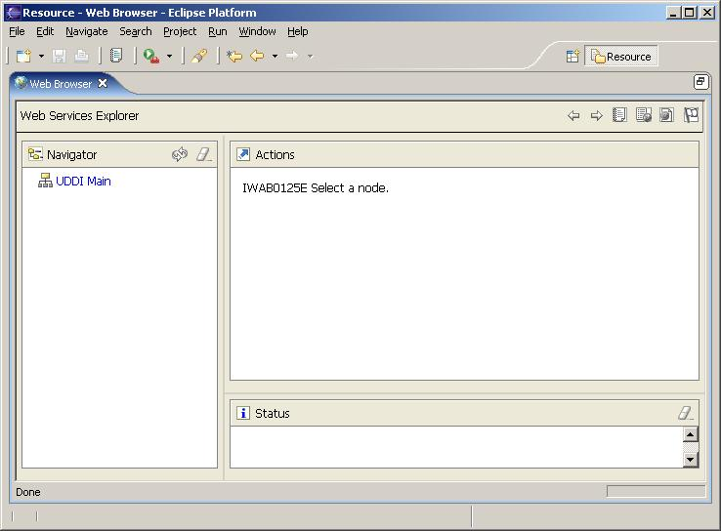
Using Web Services Explorer to test a WS
Launch the Eclipse WTP workbench.
From the main menu bar, select Run -> Launch the Web Services Explorer.

Slide 60
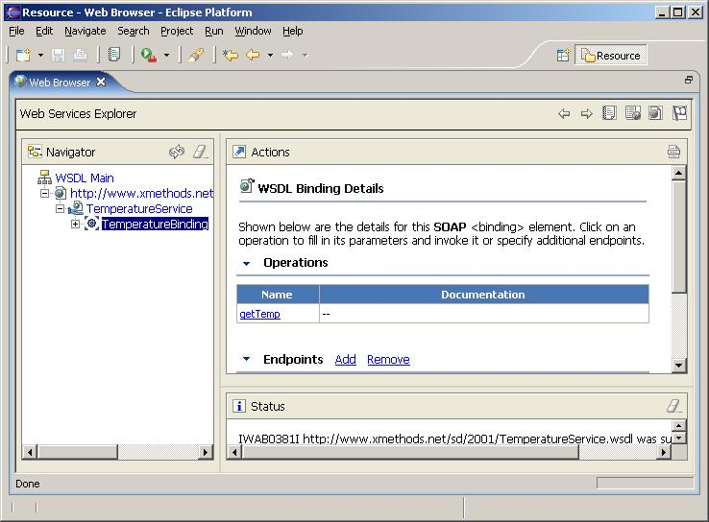
Discover, Open, and Test a WS

Slide 61
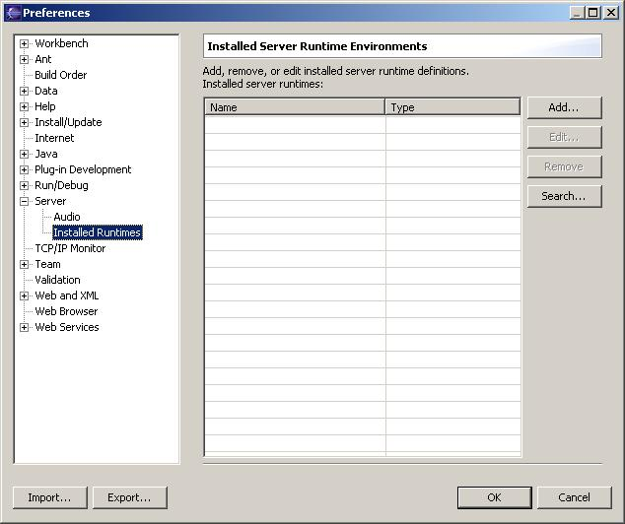
Build a Web service bottom-up from Java
Start the Eclipse WTP workbench.
Open Window -> Preferences -> Server -> Installed Runtimes to create a Tomcat installed runtime

Slide 62
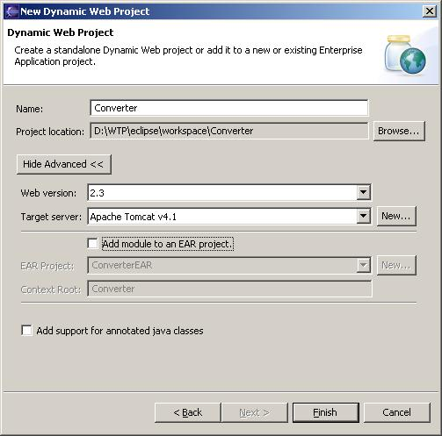
Create a Web Project
Open File -> New -> Other... -> Web -> Dynamic Web Project to create a new Web project named Converter.
Enter Converter into the Name field.
Choose a Web version of 2.3.
Choose a Target server of Apache Tomcat v4.1.
Deselect Add module to an EAR project. Result:

Slide 63
Building a Web Service Client (Application)
Import the wtp/Converter.java class into Converter/JavaSource (be sure to preserve the package).
Select the file.
Open File -> New -> Other... -> Web Services -> Web Service.
Select Generate a proxy.
Select Test the Web service.
Select Overwrite files without warning.
The diagram on next page will appear:

Slide 64
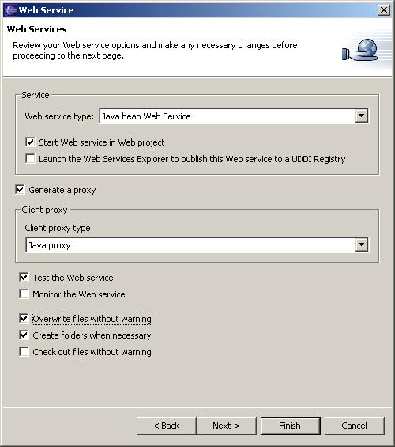
Create a Web Service

Slide 65
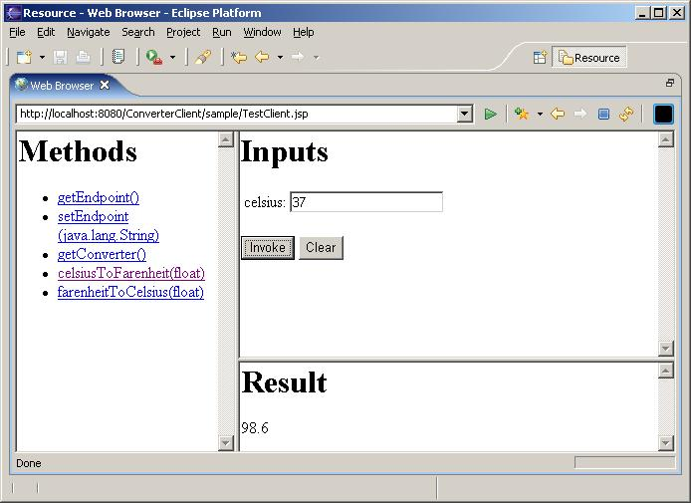
Invoke a Method in the Java Class

Slide 66
SUMMARY
Overview of SOC Development Environments
Service provision and hosting: Use ASP .Net to develop C# based Web Services and host them IIS.
Service broker: UDDI Data Models / Data Structures
Service requester: Use ASP .Net to develop Web services-based applications
.Net Remoting
AJAX Dynamic Web Programming
Java-Based Web services and Web Application Development Environments
As service provider
As service requester

